Slide 1
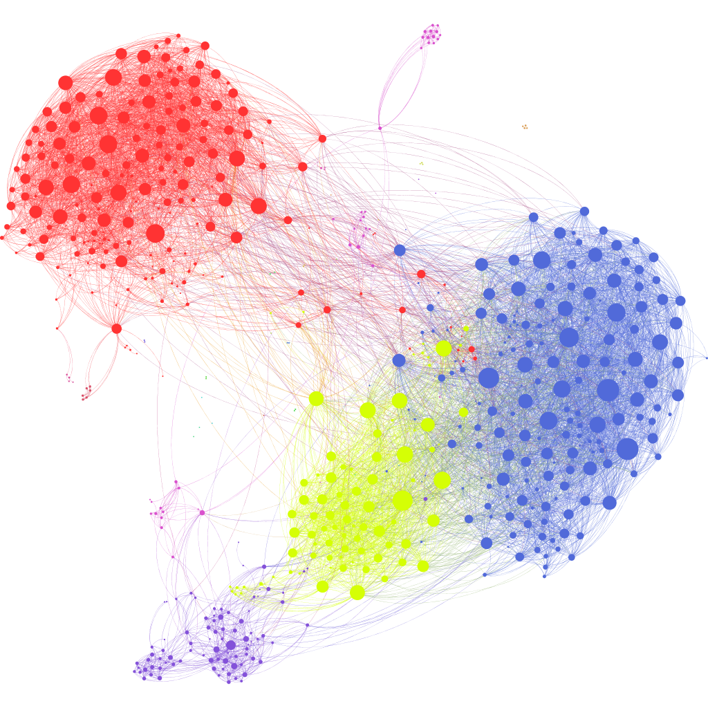
Lecture 1
Classification, Neural Networks and Backpropagation

Slide 2
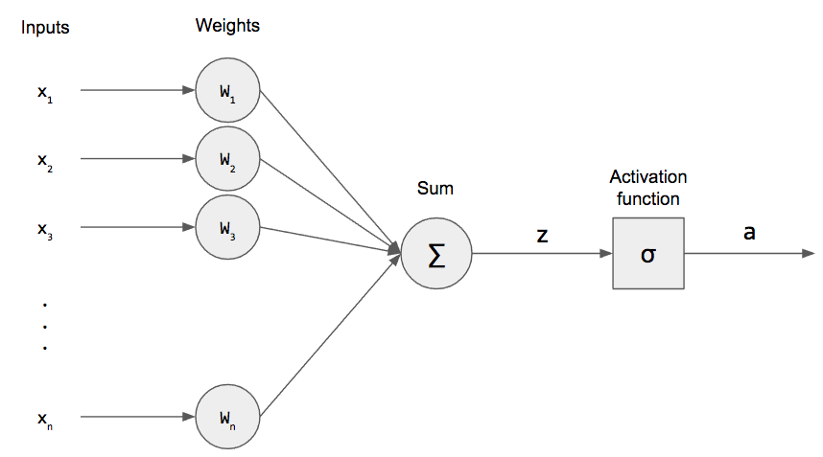
Perceptron

Slide 3
How do we find the most optimal weights?
A nice demo

Slide 4


Slide 5
Gradient based optimization
Most deep learning algorithms involve some sort of optimization.
The function f(x) that we want to minimize or maximize is called objective function
In the case when we minimize it, we also call it loss function or cost function.

Slide 6
Gradient based optimization
The derivative f’(x) gives us the slope of a function f(x) in the point x.
Therefore, it shows us how to scale a small change in the input, in order to obtain the corresponding change in the output f(x + 𝝐) ≈ f(x) + f’𝝐(x)
For functions with multiple inputs, we must make use of the concept of partial derivatives. ∂/∂x_{i} f(x) measures how f changes as only the variable x_{i} increases at point x.

Slide 7
Gradient based optimization
The gradient generalizes the notion of derivative to the case where the derivative is with respect to a vector.
The gradient of f is the vector containing all of the partial derivatives, denoted ∇xf (x).

Slide 8
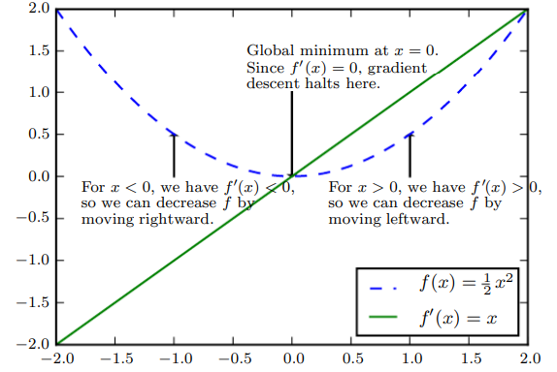
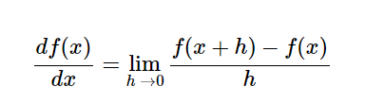
Gradient based optimization
Image: “Deep Learning” book from Ian Goodfellow

Slide 9
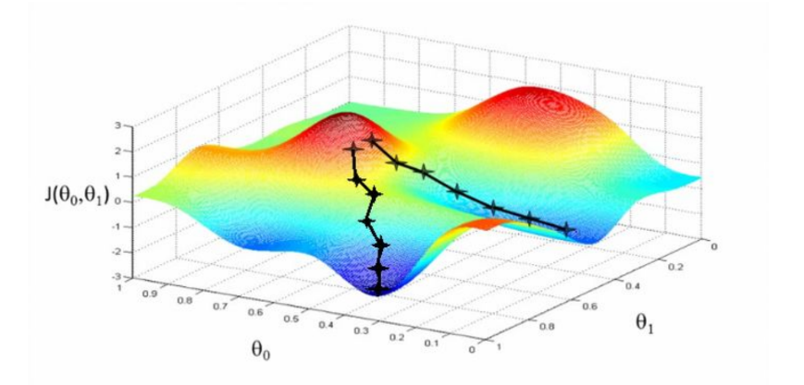
Gradient descent
Update rule for the parameters of the function: 𝑥’ = 𝑥 - 𝝐▽x𝒇(𝒙)
𝝐 - learning rate, positive scalar determining the size of the step made

Slide 10
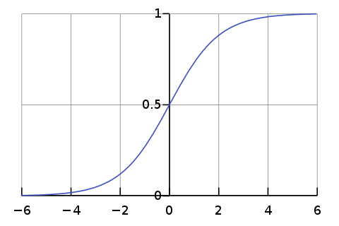
Activation functions: sigmoid = 1/1+e^(-x)

Slide 11
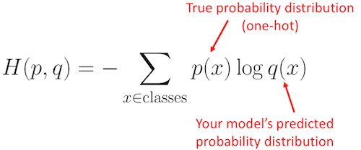
Example: Cross Entropy loss
Measure difference between two probability distributions

Slide 12
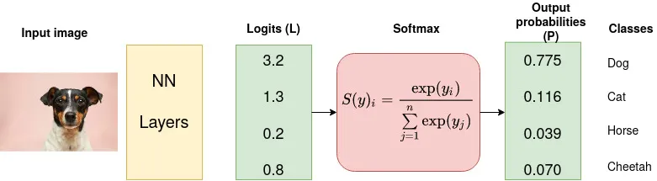
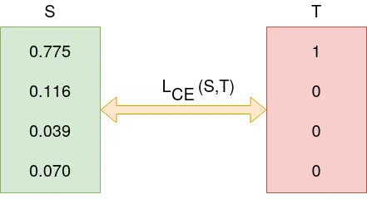
Images: https://towardsdatascience.com/cross-entropy-loss-function-f38c4ec8643e

Slide 13
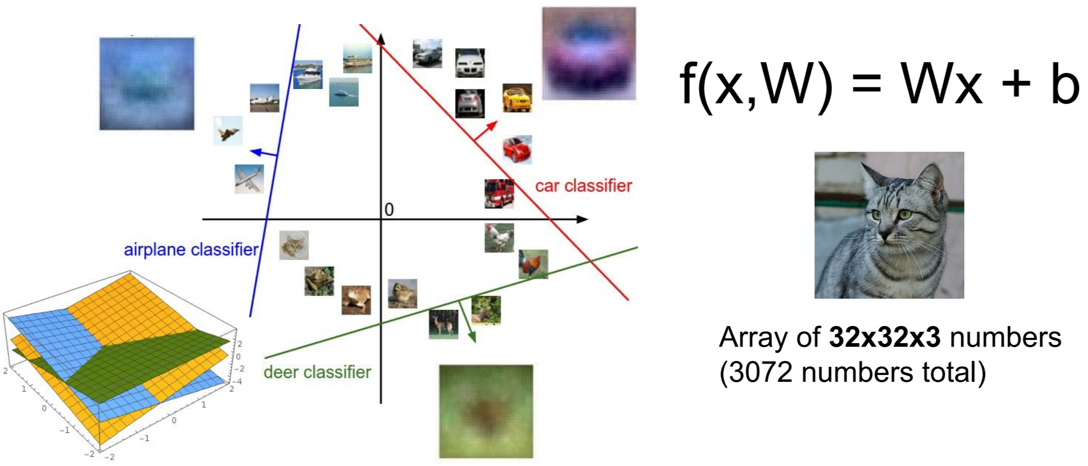
Linear Classifier: interpretation

Slide 14
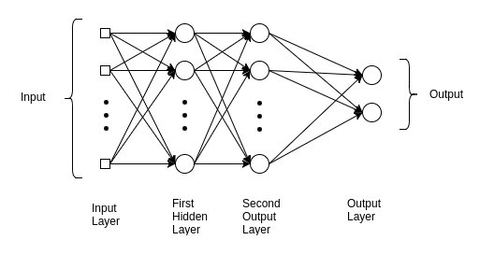
Multilayer perceptron

Slide 15
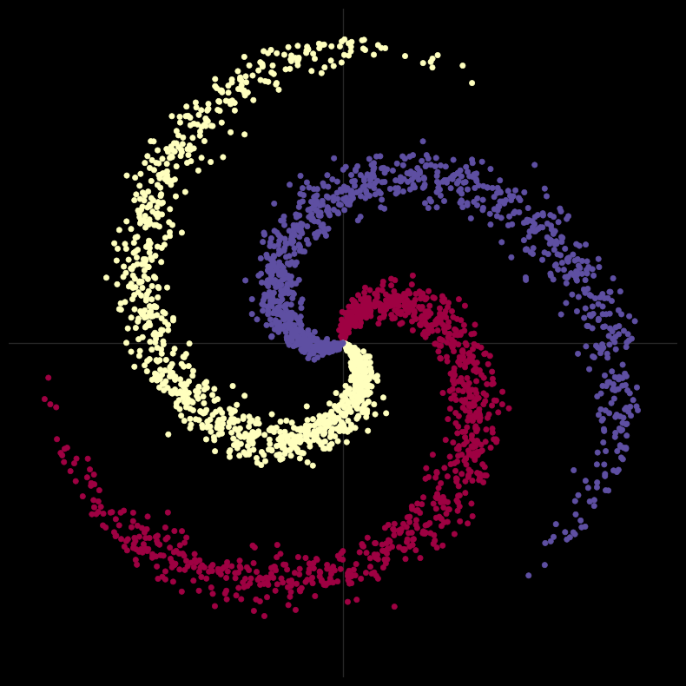
But datasets are almost never that well separated….

Slide 16
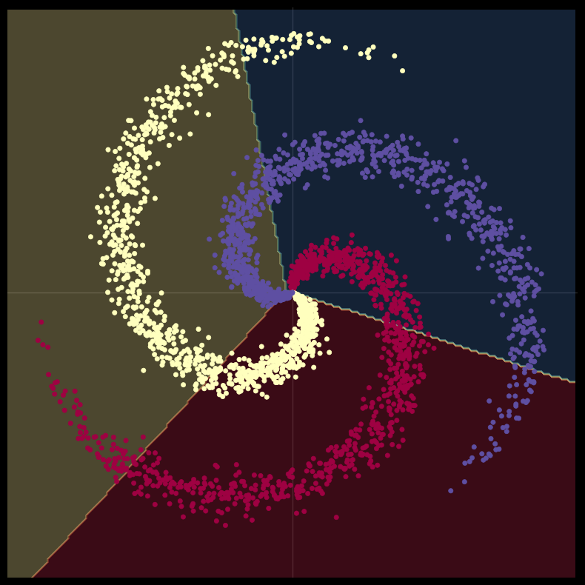
Spiral classification only with linear transformations

Slide 17
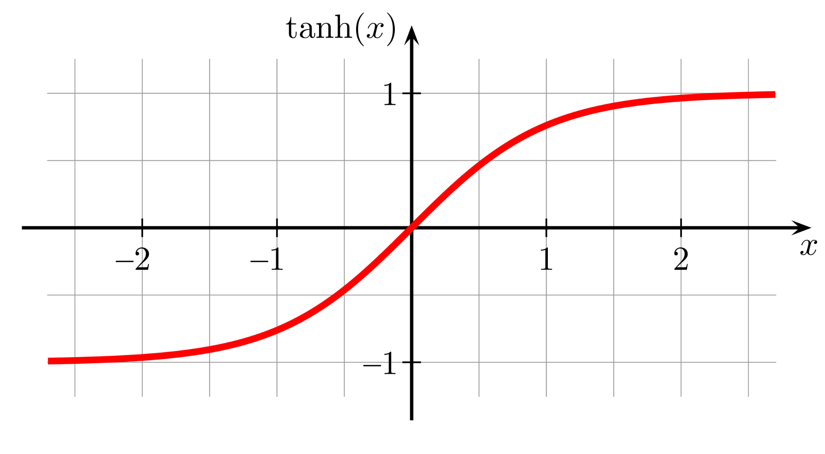
Non-linear transformations
Linear transformations can rotate, stretch, translate, but they do not make curves
That’s why we need non-linearities
E.g tanh(x)

Slide 18
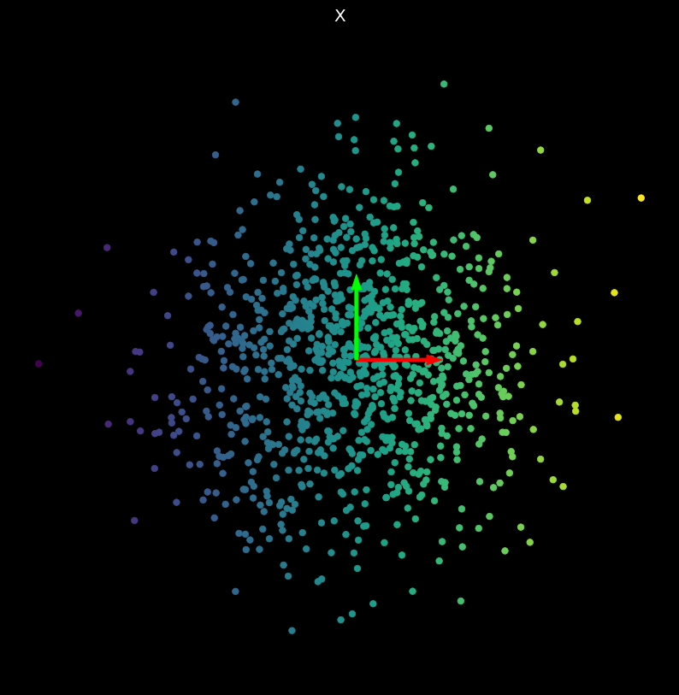
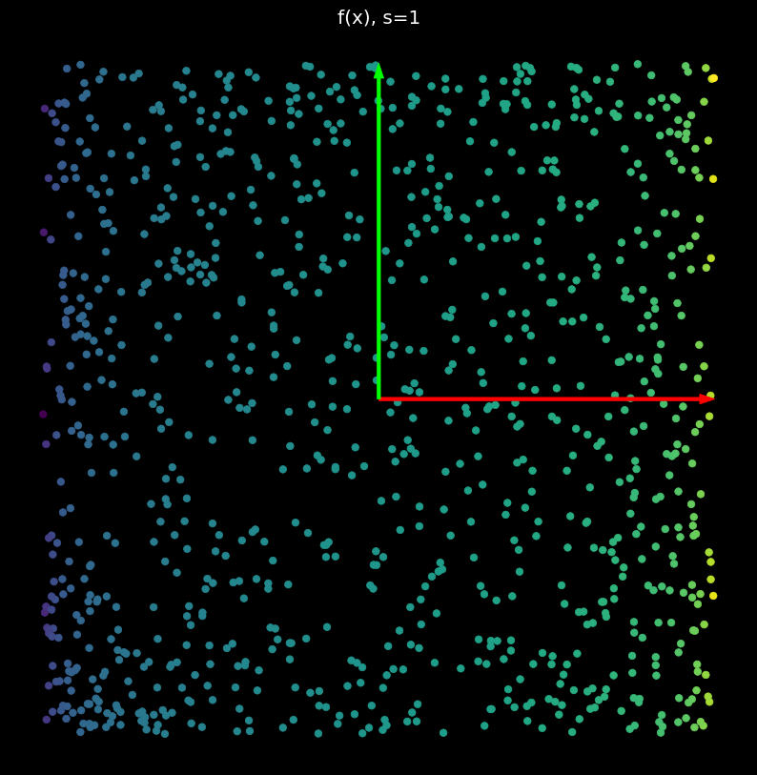
Non-linear transformations

Slide 19
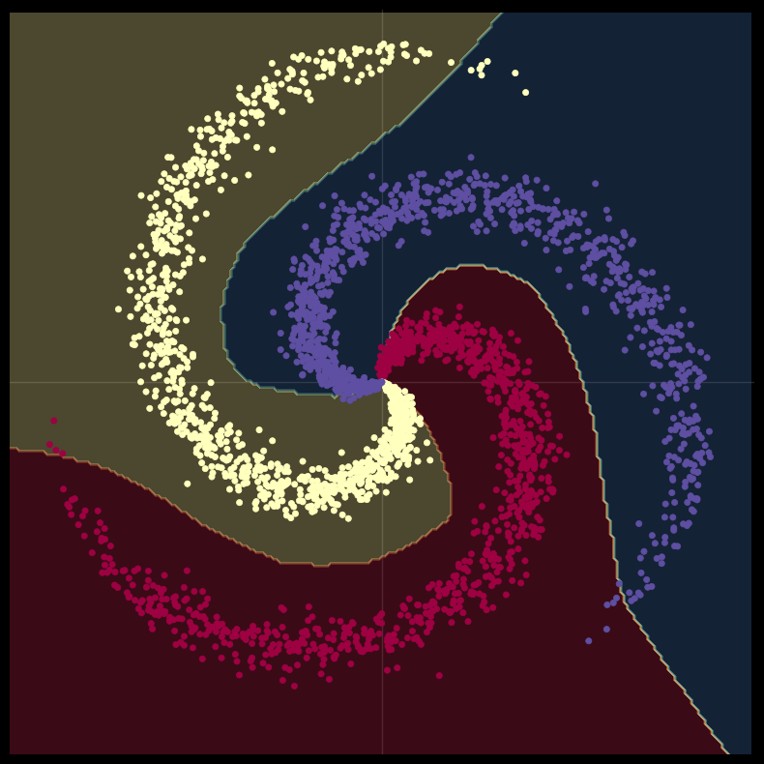
Spiral classification after adding non-linear transformations

Slide 20
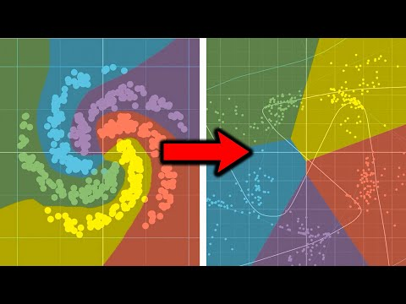
Visualization of input space

Slide 21
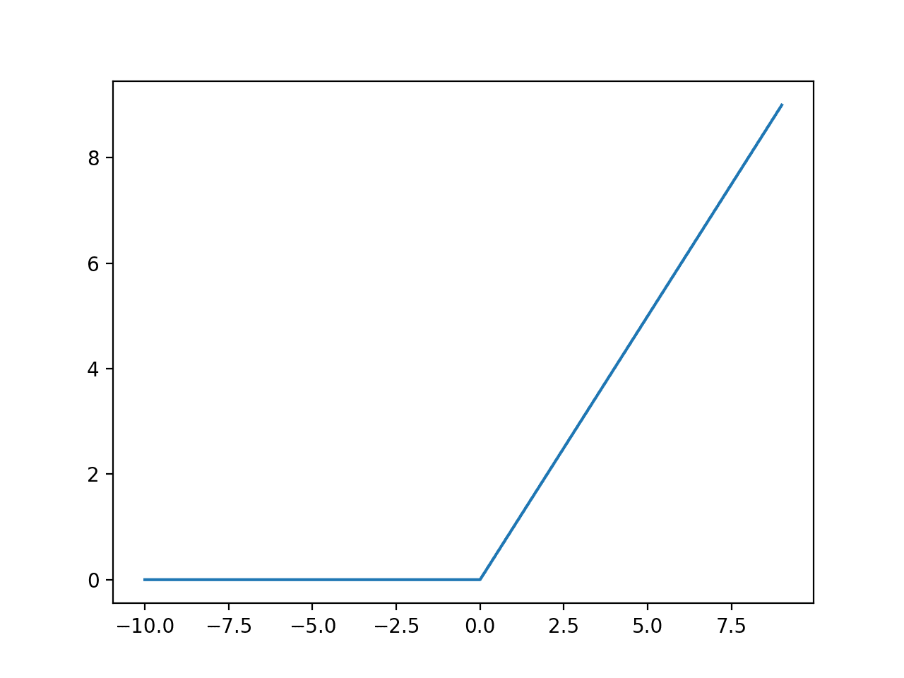
Other activation functions: ReLU = max(0,x)

Slide 22
In simple words:
Neural networks rotate (apply linear transformations) and twist (non-linear transformations) the input space, so that the data points become linearly separable
Then the problem of training neural networks becomes how to find the most optimal weights (matrices).

Slide 23
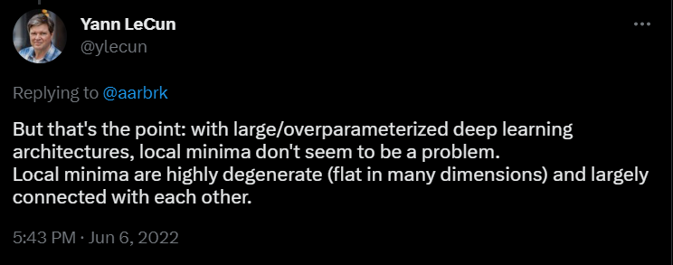
In high dimensions, local minima does not seem to be a problem

Slide 24
How do we find the gradients?

Slide 25
Neural networks can have multiple layers with thousands and even millions of parameters
Problem: How do we compute the partial derivative of each weight w.r.t. the loss function?
Idea: Backpropagation (a.k.a. chain rule)

Slide 26
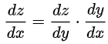
Backpropagation
Note: Backpropagation is NOT an optimization algorithm. NNs are trained (optimized) by Gradient descent, which uses the gradients computed by Backprop.
Recap - chain rule: h(x) = f(g(x)). Then h’(x) = f’(g(x)).g’(x)
More convenient notation:

